Slide 1

DEPLOYFASTER DEPLOYWITH APPJET
Mestrado em Engenharia de Software
Aluno: Guilherme Malhado
Orientador: Professor Doutor João Ventura
Open-source platform for deployment automation and configuration over web infrastructures.
1

Slide 2

~ Betty Williams
“There’s no use talking about the solution unless you talk about the problem.“
2

Slide 3
Problem
That we are trying to solve
3

Slide 4
Problem
Time-consuming & Complex
Errors & Inconsistencies
High Complexity
Non-User Friendly
Paid
Black Box
Server/Environment Setup
Deployment
Internal Manual Processes
Complex toolchains with Huge amount of configurations and specifications
Most of this tools, have a limited feature free version
Usually we can’t configure the core of this tools, only its surroundings
User Interface not friendly or absence of it.
4

Slide 5
What’s the Solution?
5

Slide 6
Solution
Automate Web Applications Configuration & Deployment
Click-to-go
Core Configuration file
Open Source
https://github.com/guilhermemalhado1/appjet
6

Slide 7
But, how?
7

Slide 8



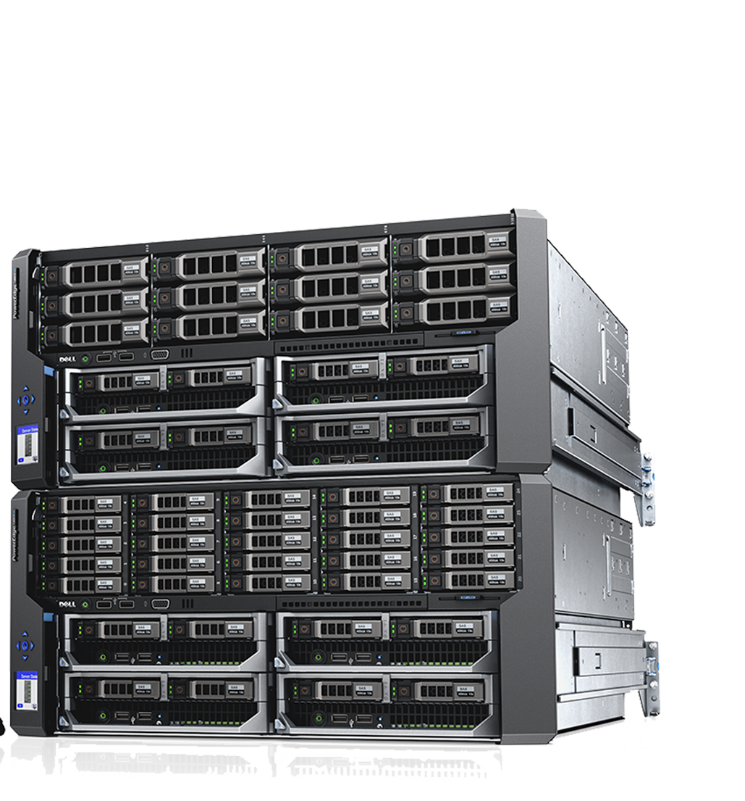




APPJET CENTER
ADecision Manager
AServer Daemons
Server A.1
ADocumentation
AMonitoring
Cluster
HTTP/JSON
Server A.2
HTTP/JSON
Server A.N
SCP
AUTH TOKEN
DATABASE
ACLI
8

Slide 9
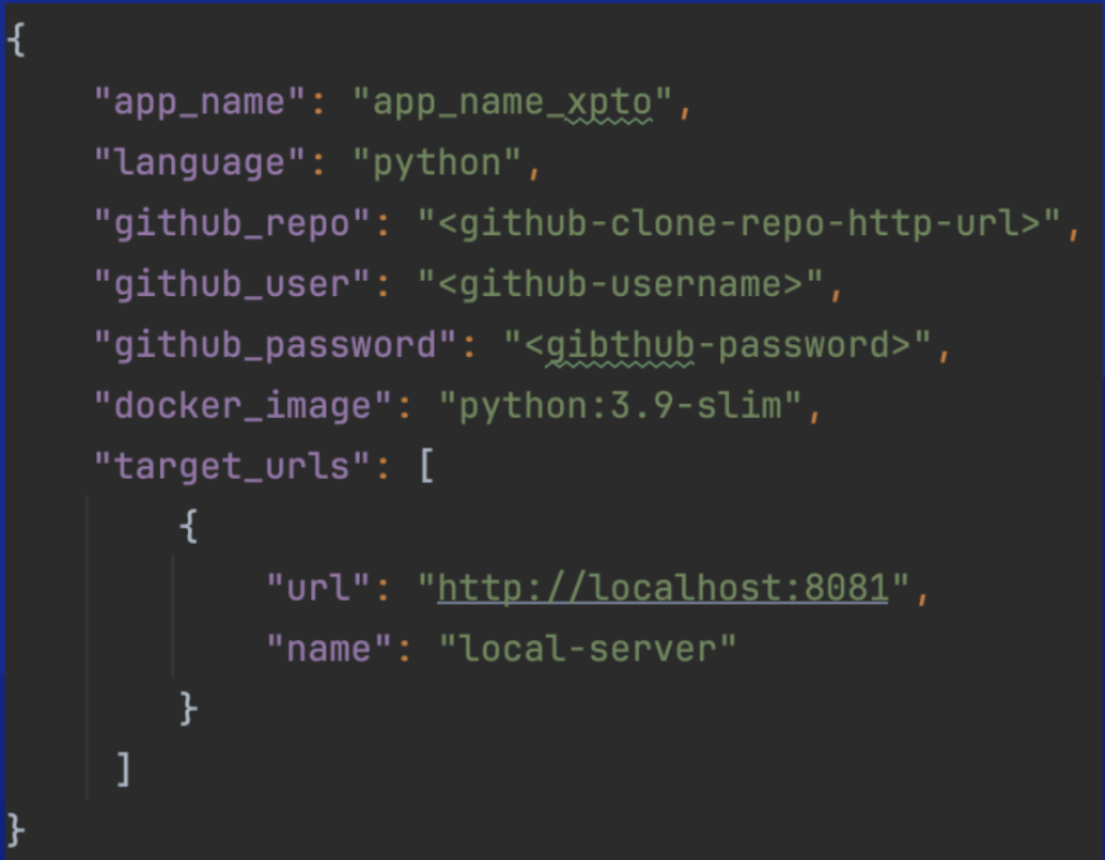
Core Configuration file
9

Slide 10

APPJET Workflow
./appjet login
./appjet deploy
./appjet status
etc
App Running Server1
Cluster
App Running Server2
App Running Server3
ACLI
10

Slide 11



APPJET some cons
Community & Support
Limited Third-Party Integrations
Legacy Applications
incompatibility
Emerging platform, small community in comparison to other bigger platforms
As it is a PoC, It doesn’t cover all the scenarios on the Work Market
Django, SpringBoot
11

Slide 12
Some Competitors
12

Slide 13


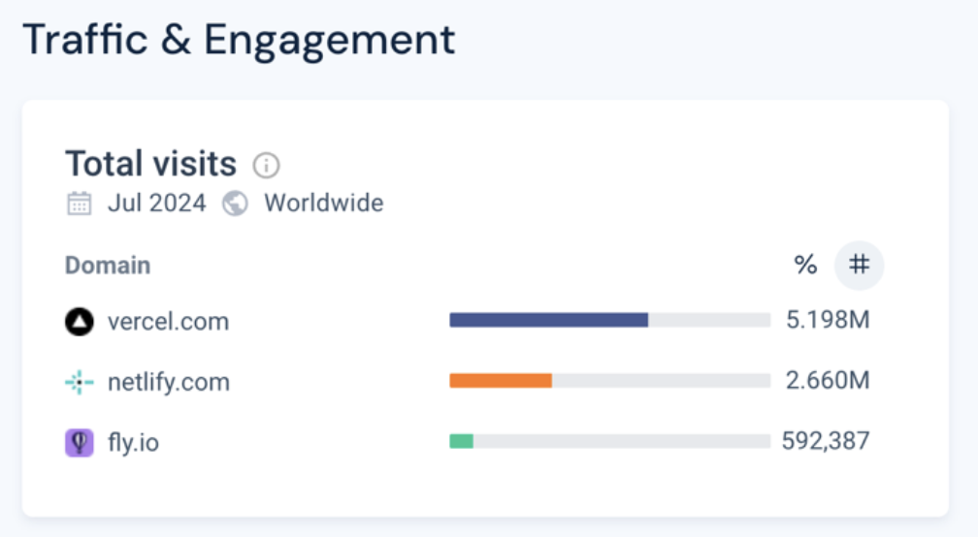

https://www.semrush.com/projects/
https://pro.similarweb.com/
https://www.crunchbase.com/
13

Slide 14
USAGE Tests
14

Slide 15
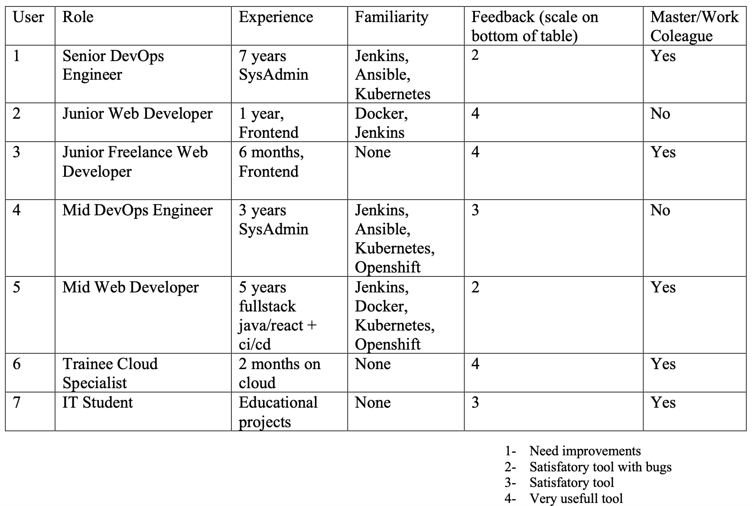
Users Profile Overall Feedback
Detailed on the report
15

Slide 16
Short Demonstration
16

Slide 17
DEPLOYFASTER DEPLOYWITH APPJET
Mestrado em Engenharia de Software
Aluno: Guilherme Malhado
Orientador: Professor Doutor João Ventura
https://github.com/guilhermemalhado1/appjet/blob/master/docs/README.md
Open-source platform for deployment automation and configuration over web infrastructures.
17

